Slide 1
Numerical Analysis (6/7) Linear systems
University of Luxembourg - 2024
Master in Mathematics
Hadrien Beriot

Slide 2
Outline
1. Introduction
2. LU decomposition
3. QR decomposition
4. Iterative methods
5. Summary

Slide 3

1. Introduction

Slide 4
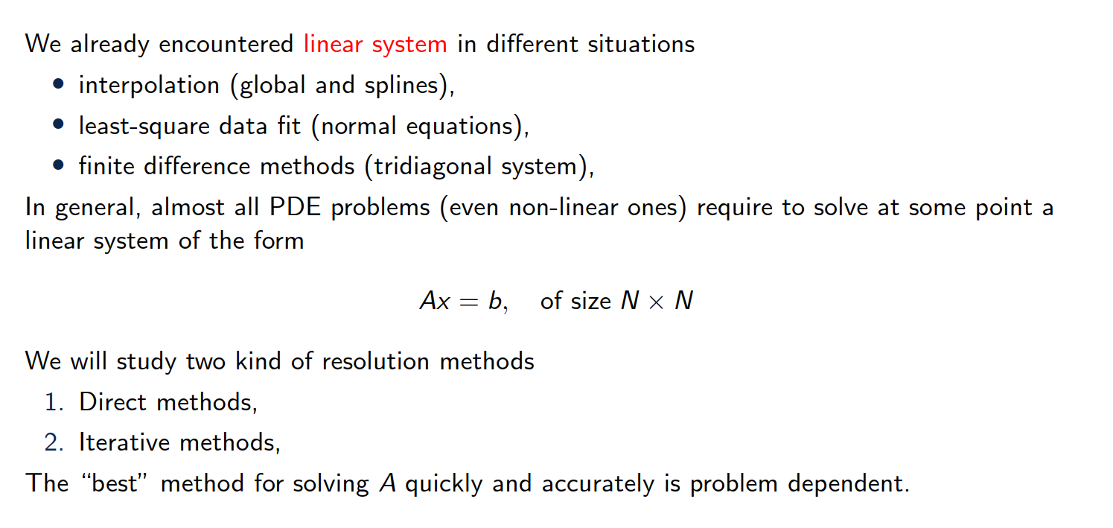
Overview of the content

Slide 5
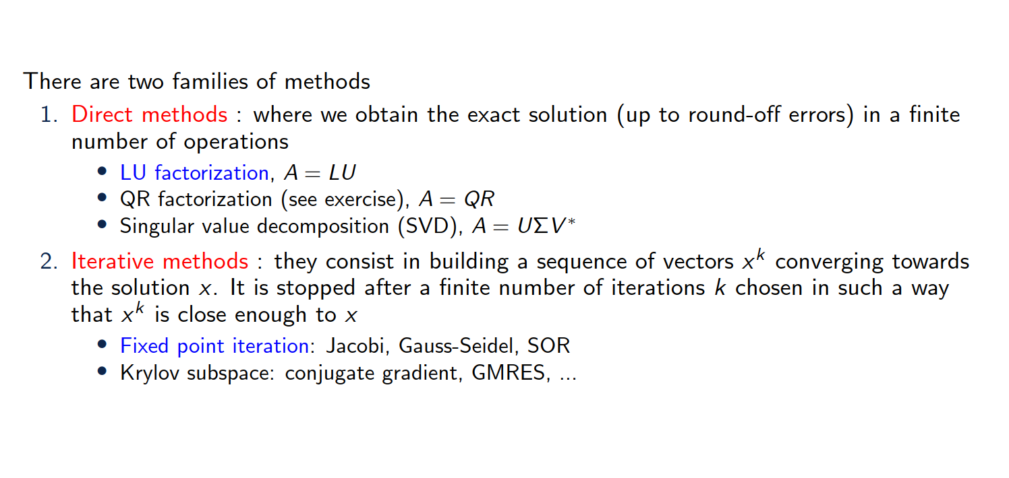
Overview of the content

Slide 6
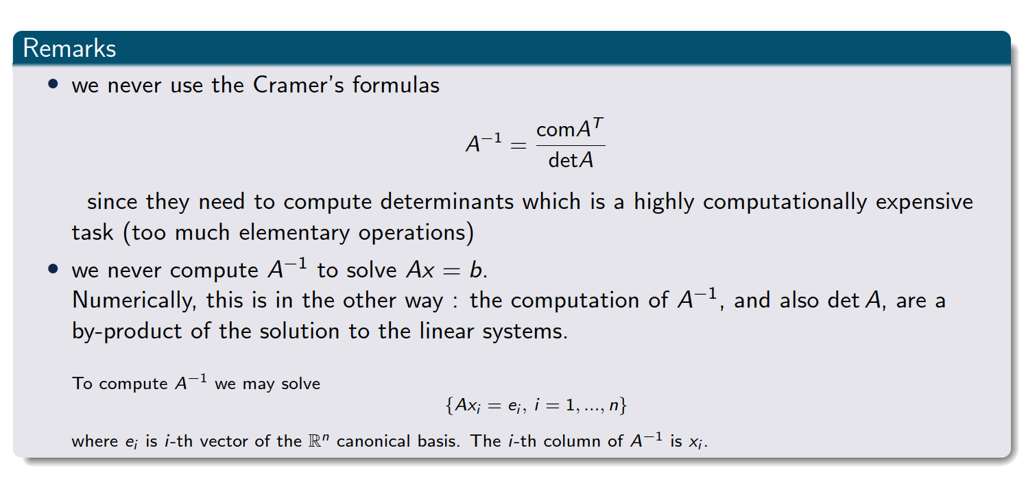
Important remarks
Notes:
The comatrix of a matrix AAA is the transpose of the matrix of cofactors of A.Each cofactor is obtained by calculating the determinant of the submatrix that remains after removing the row and column corresponding to the element in question, with an appropriate sign adjustment based on the position.

Slide 7
2. LU factorization

Slide 8
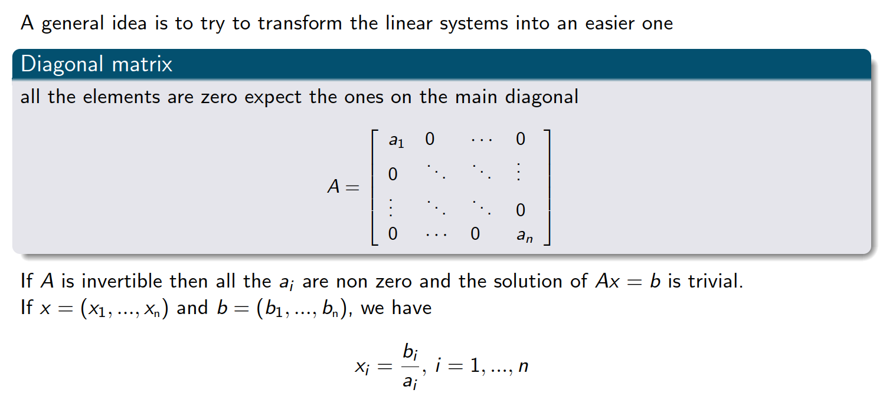
Linear system that is easy to solve

Slide 9
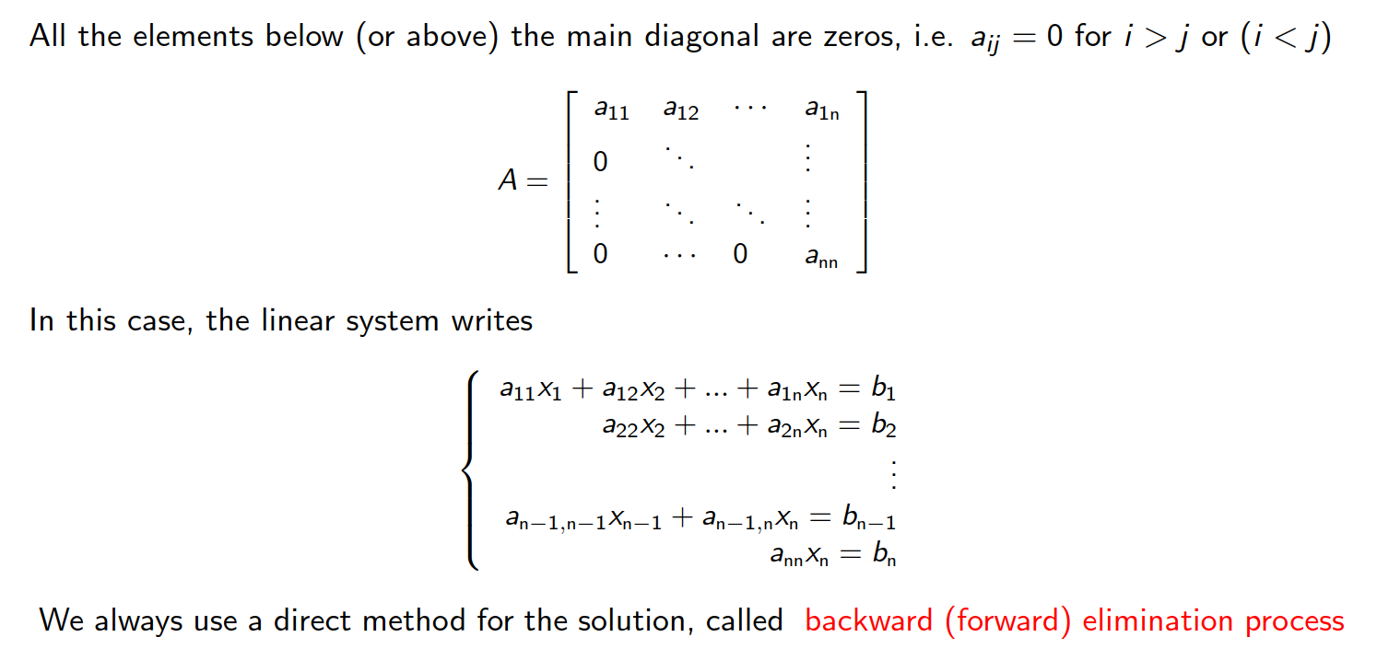
Upper (or lower) triangular matrices

Slide 10
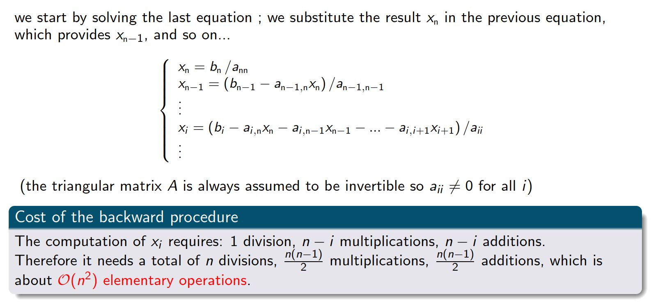
Backward substitution
Exercise 1

Slide 11
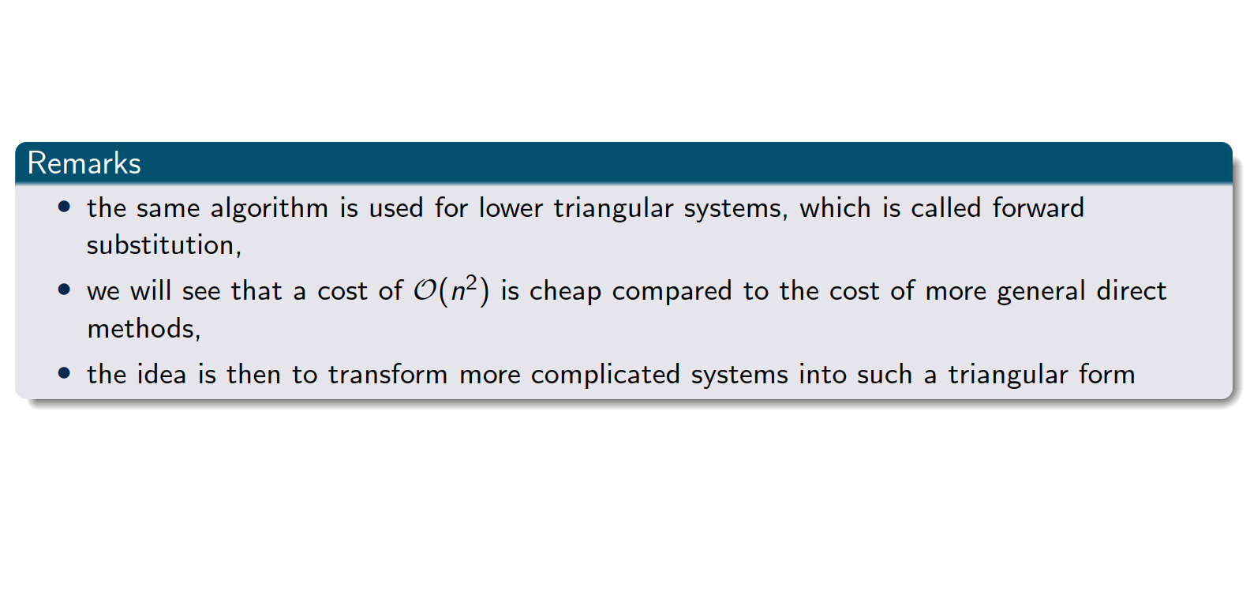
Upper (or lower) triangular matrices

Slide 12
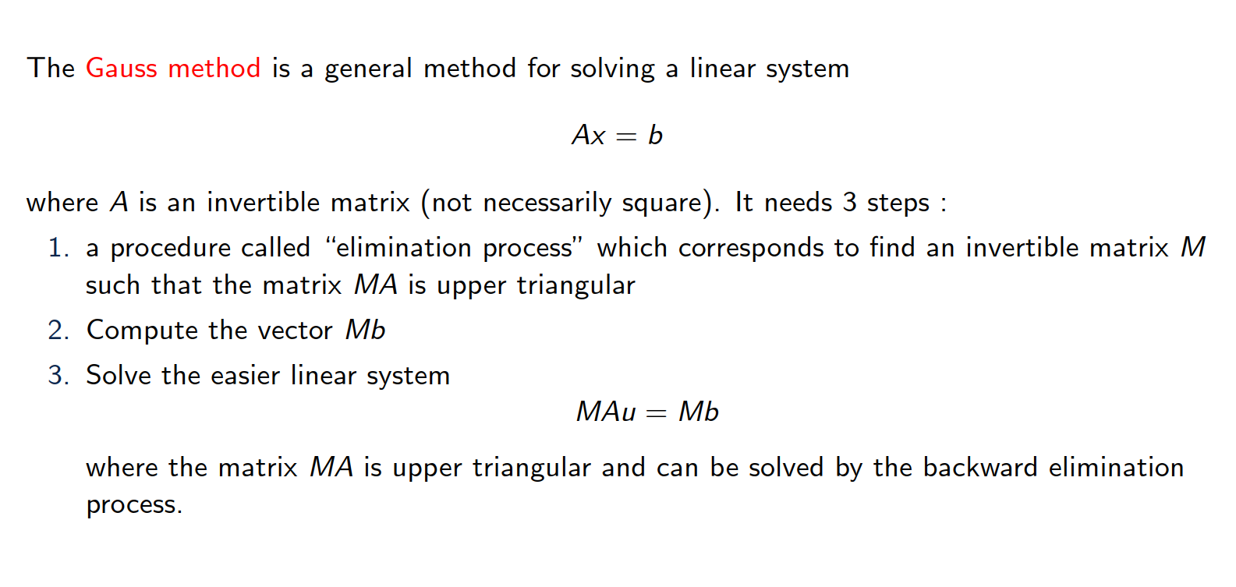
Gauss elimination

Slide 13
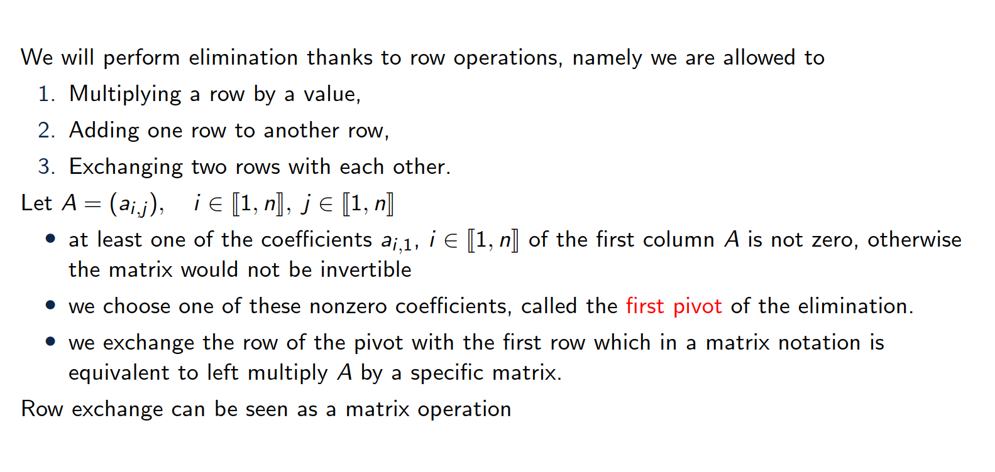
Description of the first step

Slide 14
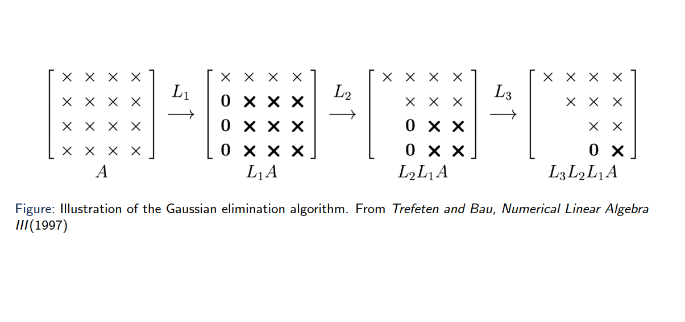
Illustration of the algorithm

Slide 15
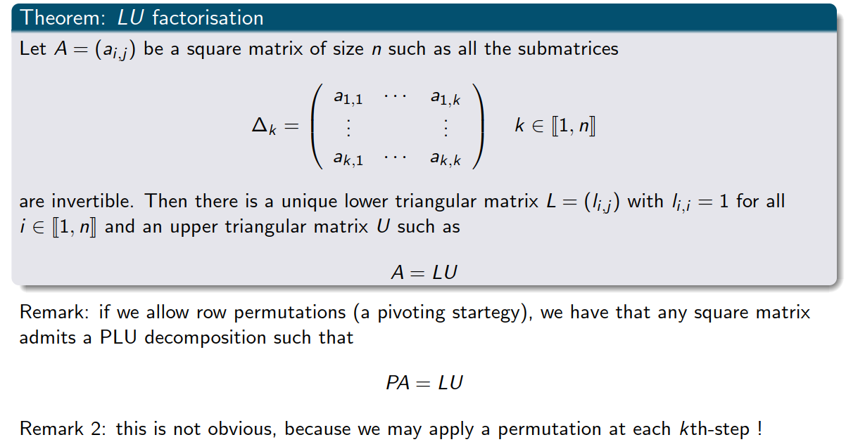
Theorem

Slide 16
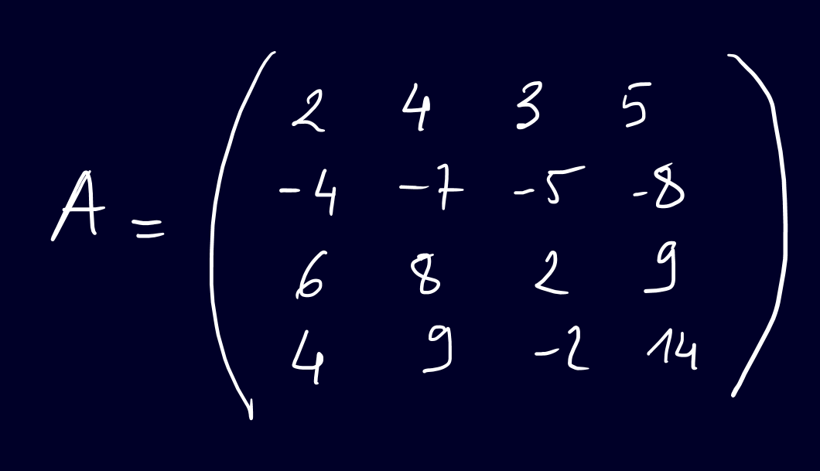
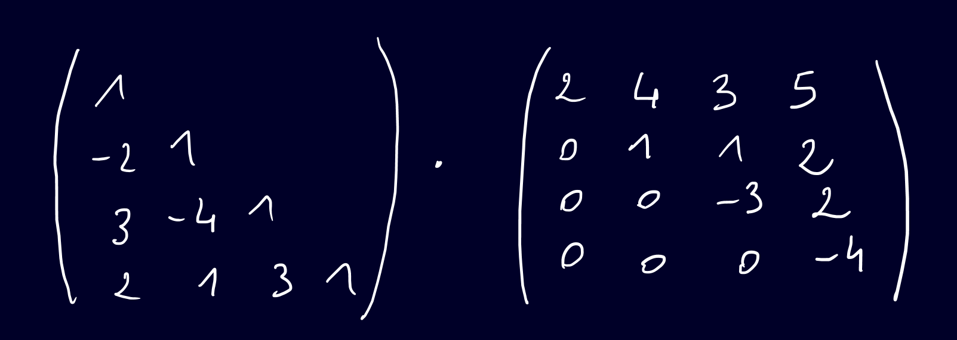



Example (hands on)
Exercise 2
Notes:
Expanded Gaussian elimination

Slide 17


Slide 18
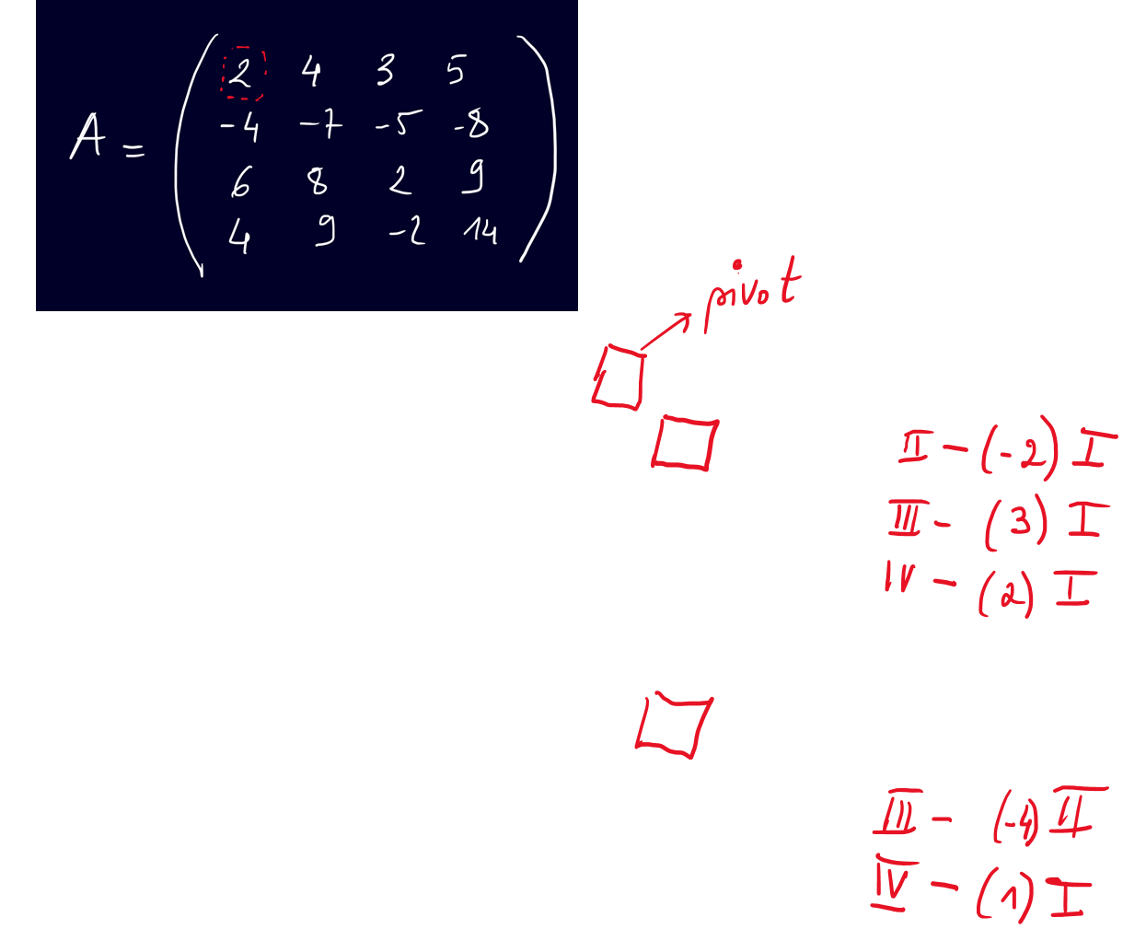




Slide 19
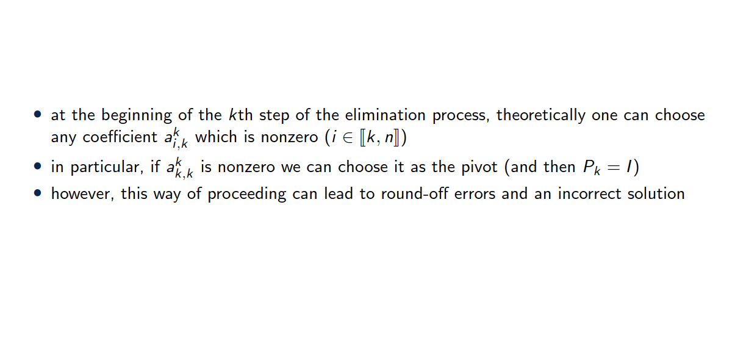
Choice of the pivot

Slide 20
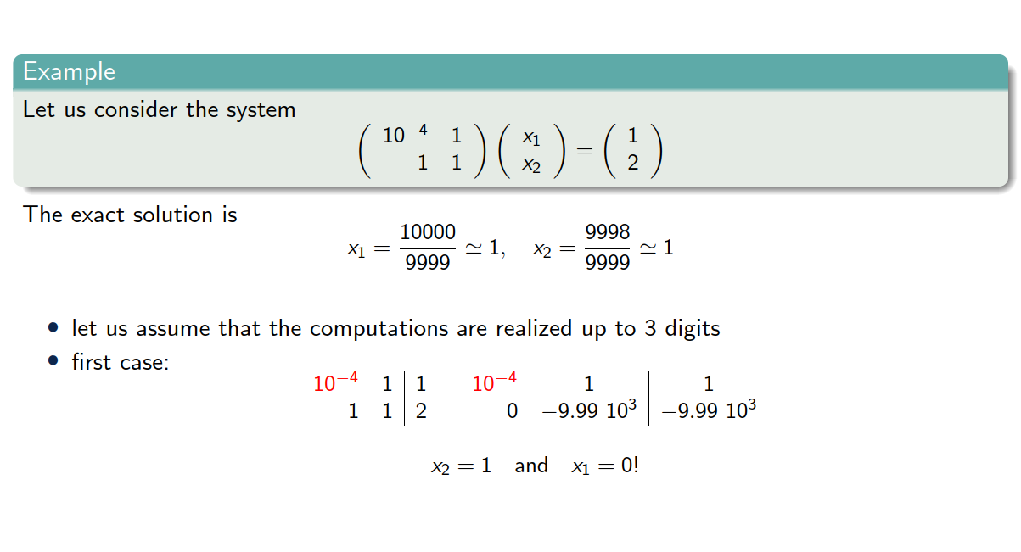
Choice of the pivot

Slide 21
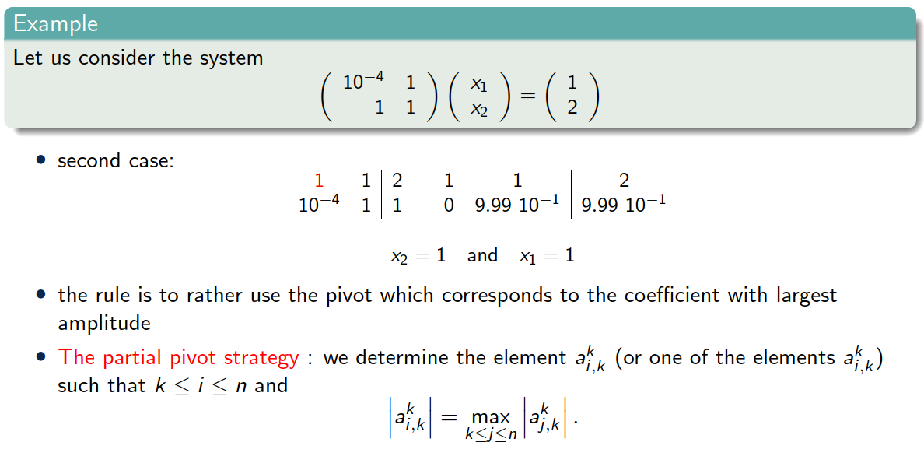
Choice of the pivot

Slide 22
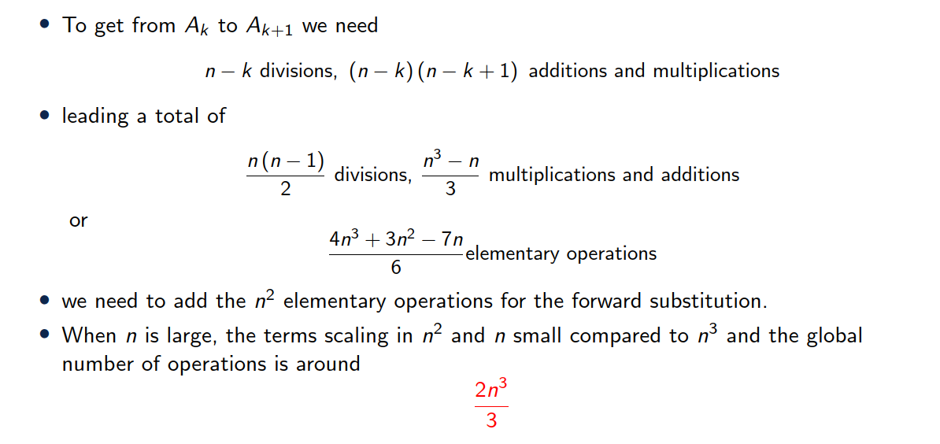
Cost of Gauss method

Slide 23
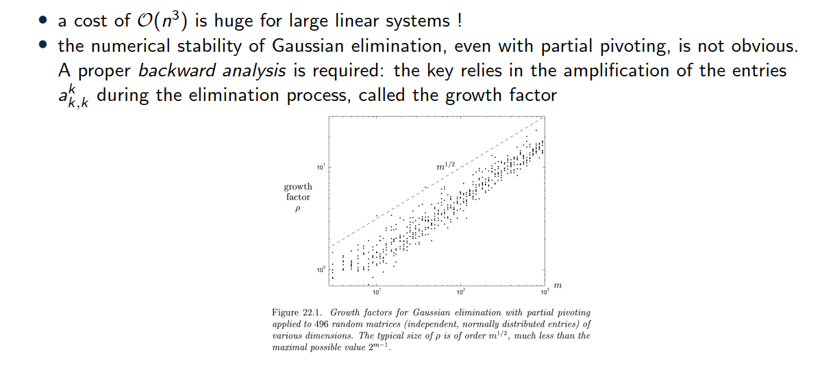
Remarks

Slide 24
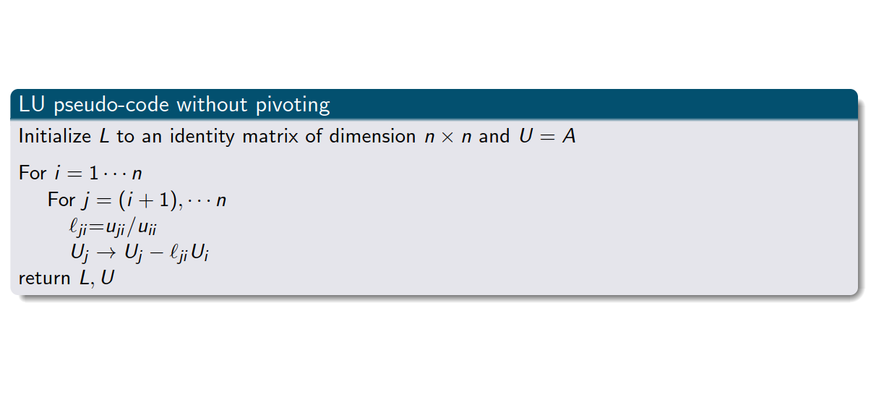
LU factorization pseudo-code
Exercise 2

Slide 25
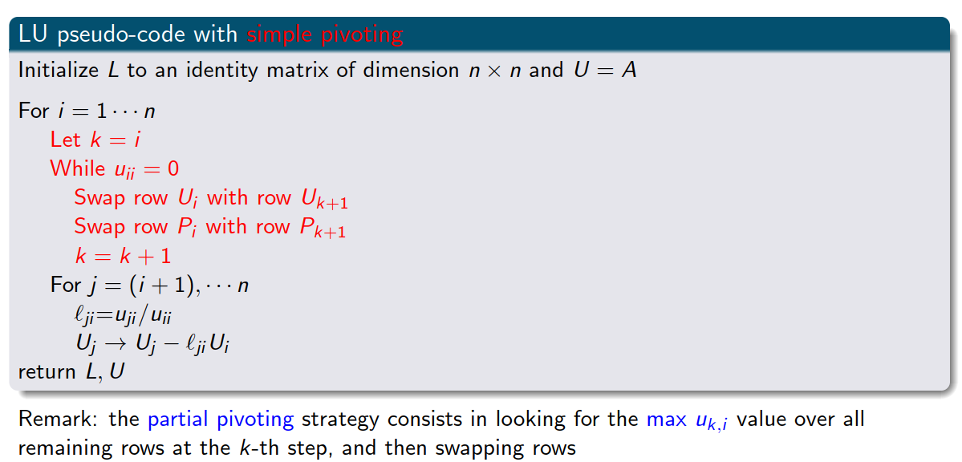
LU factorization pseudo-code with pivoting
Exercise 3

Slide 26
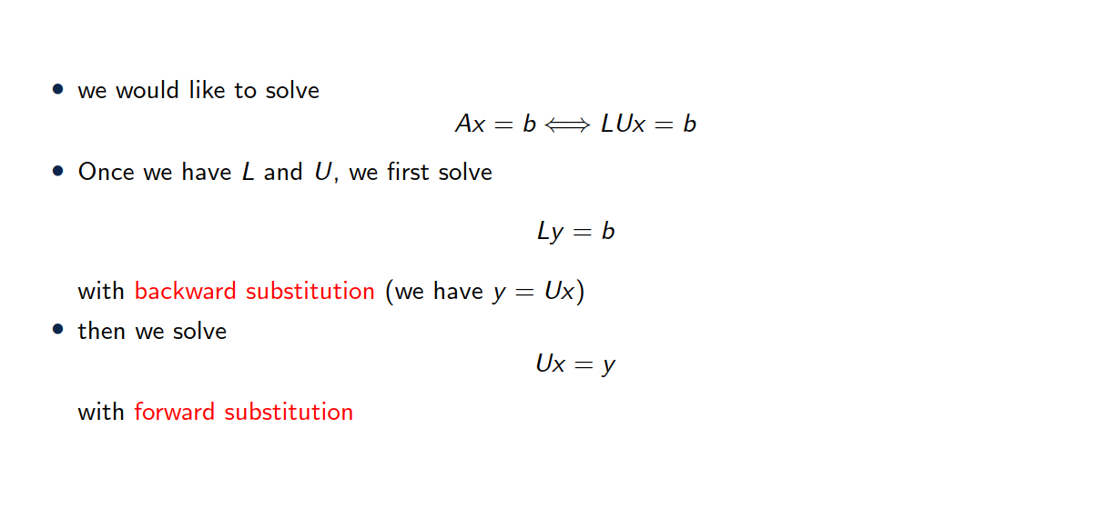
Solving a linear system with LU factorization

Slide 27
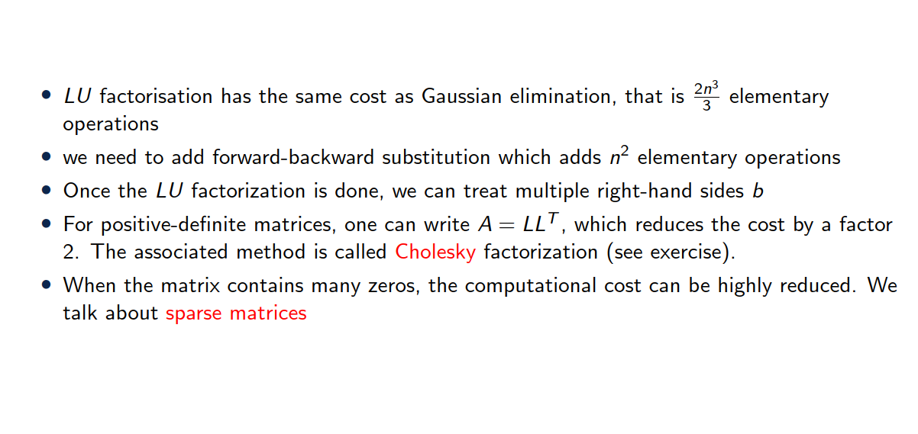
Factorization cost

Slide 28
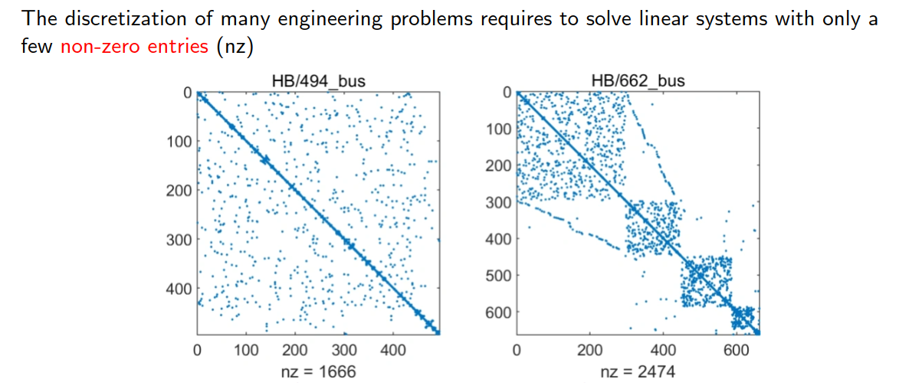
A few words on sparse matrices

Slide 29
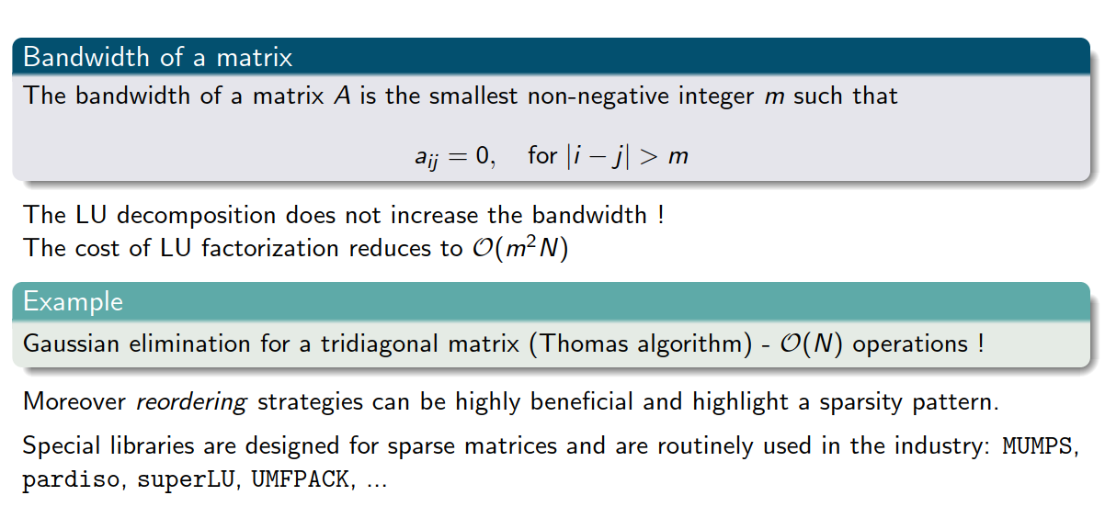
A few words on sparse matrices

Slide 30
3. QR decomposition

Slide 31
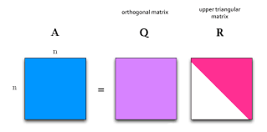

QR decomposition (for square matrices)
Definition:
Any $n×n$ matrix $A$ can be decomposed into:
$Q$: A matrix with orthonormal columns ($Q^{T}Q=I$)
$R$: An upper triangular matrix
Steps for Decomposition:
Classical Approach: Gram-Schmidt orthogonalization process.
Alternative Methods: Householder reflections or Givens rotations
Applications: Often used in least-squares problems and eigenvalue problems.

Slide 32
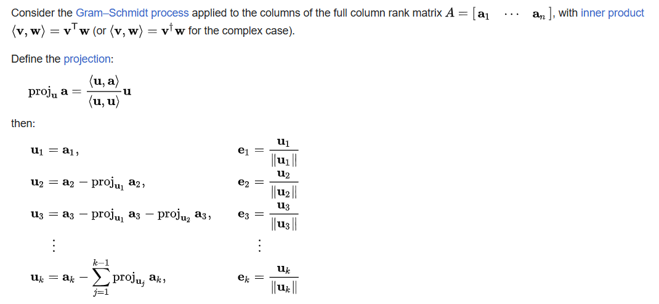
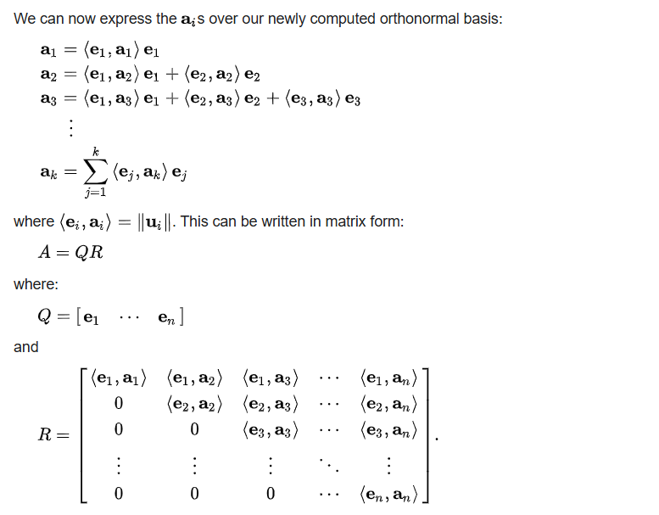
QR decomposition
https://en.wikipedia.org/wiki/QR_decomposition

Slide 33
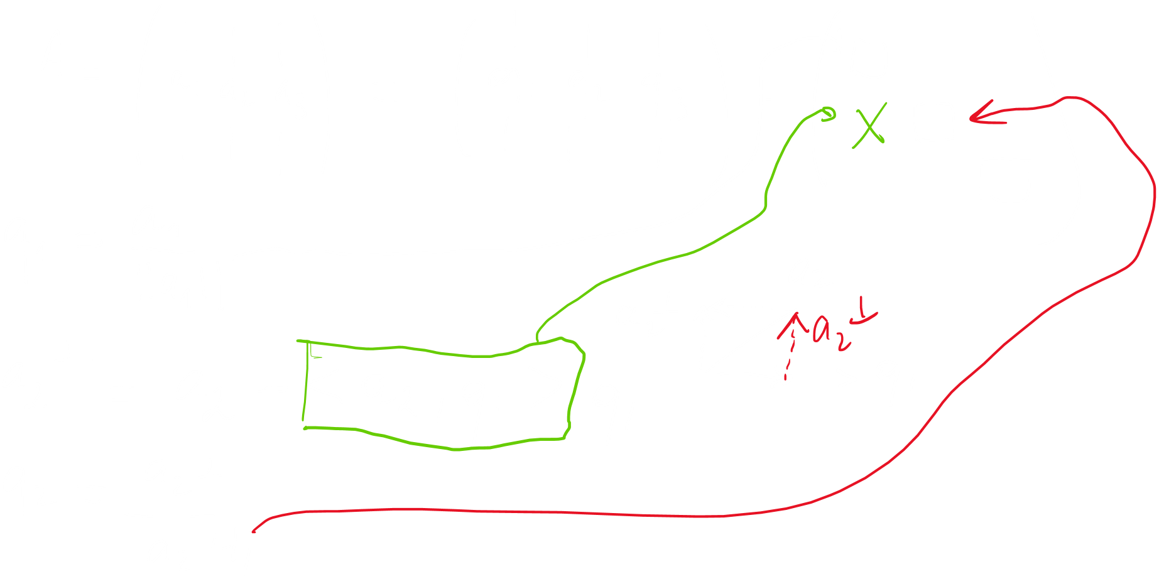




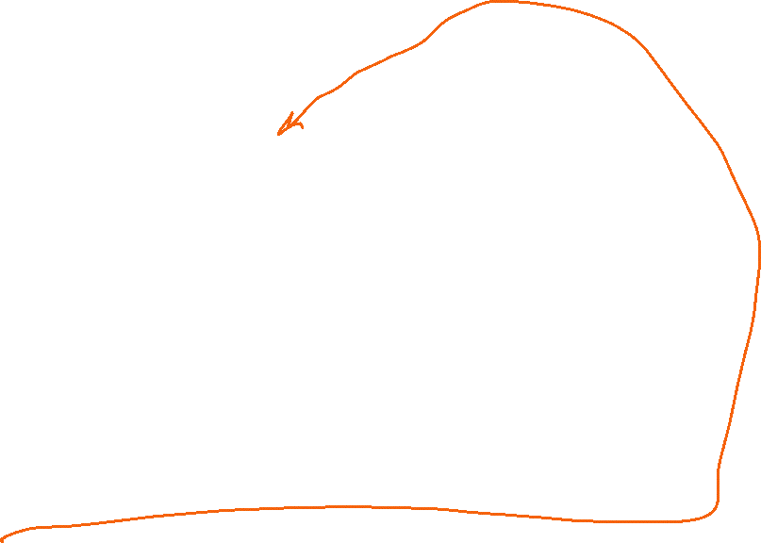













Slide 34
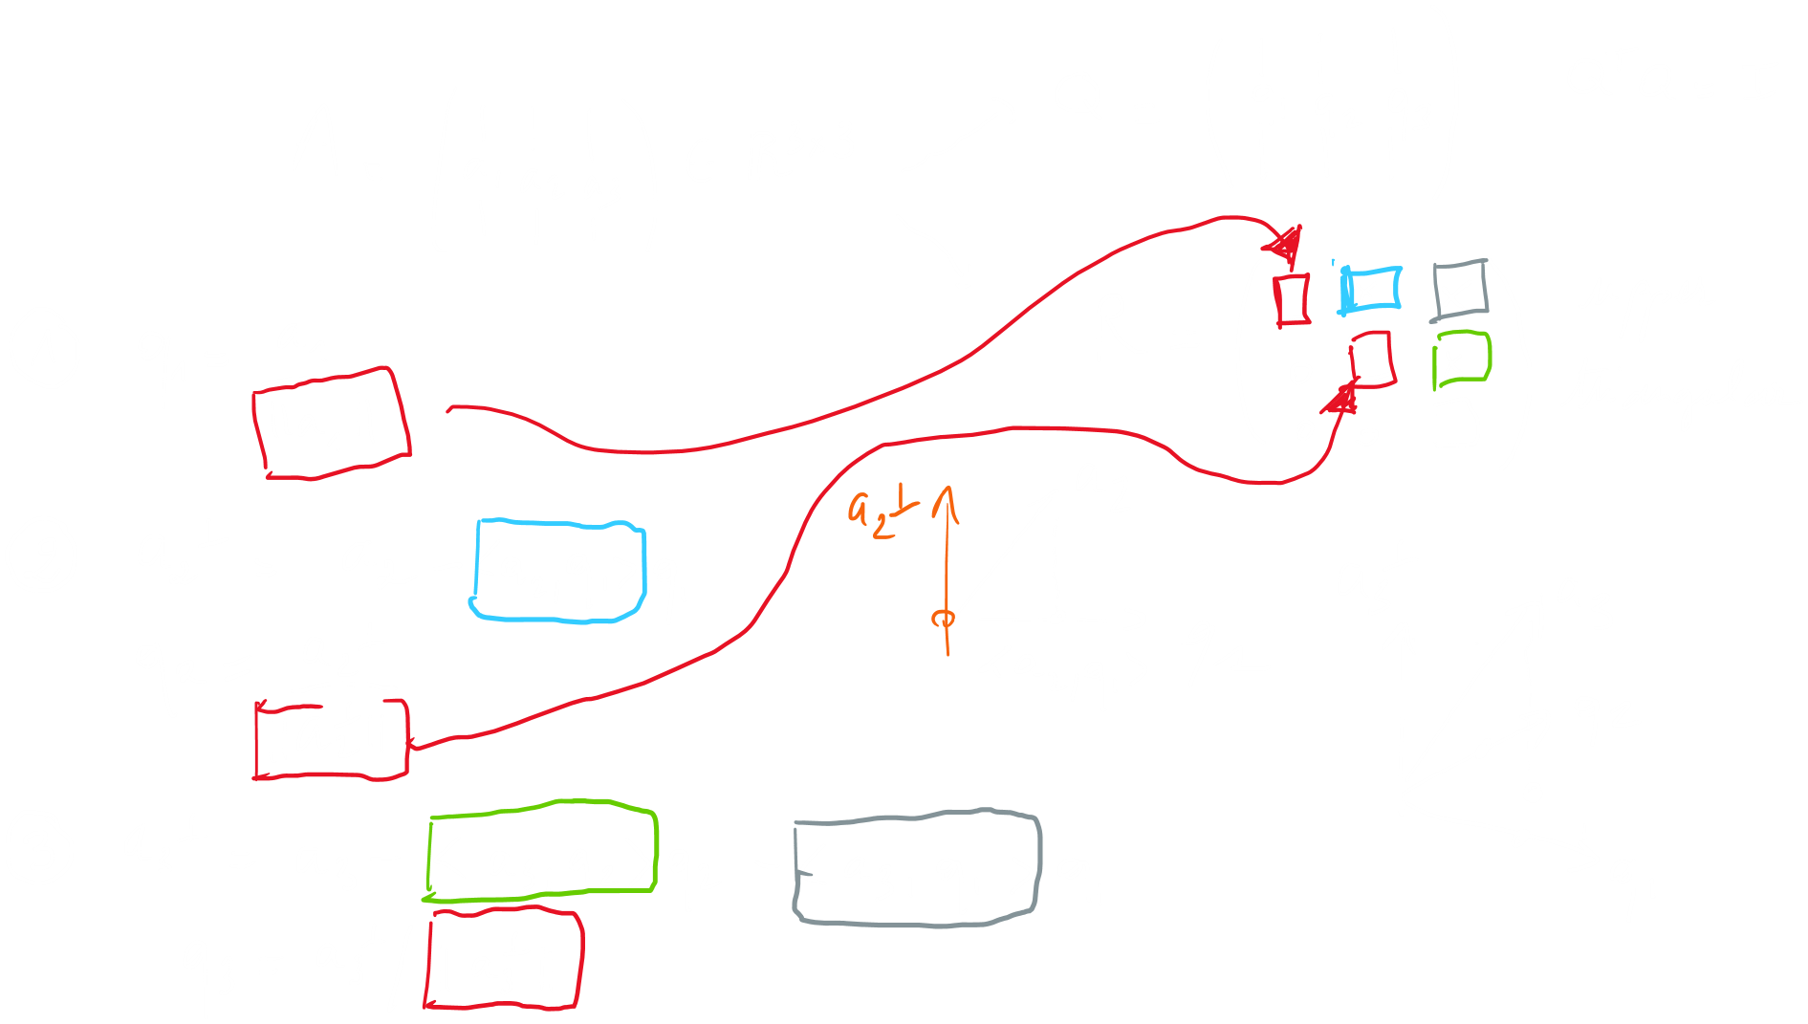
QR algorithm
The QR decomposition is based on a Gram-Schmidt orthogonalization process

Slide 35



















Example (hands on)

Slide 36
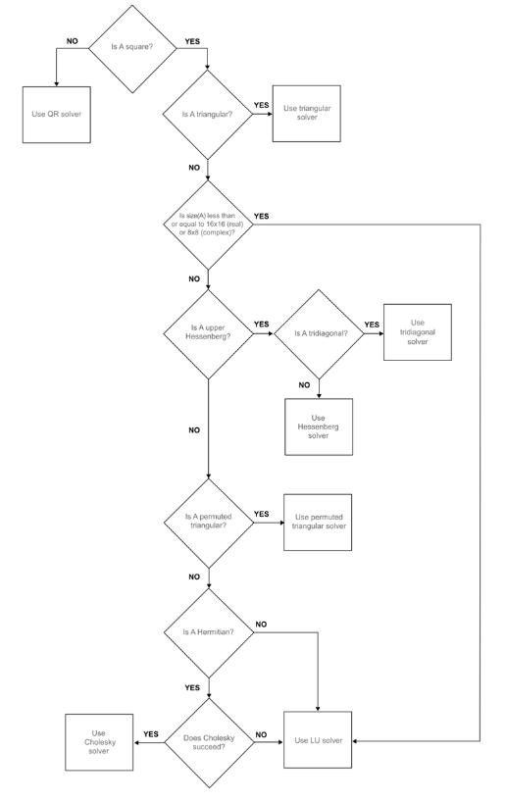
Backslah in Matlab
https://www.mathworks.com/help/matlab/ref/double.ml
divide.html
Decision tree
Use QR solver for non square matrices
Use Cholesky for square symmetric matrices
Use LU otherwise
Exercise 4

Slide 37
3. Iterative solvers

Slide 38
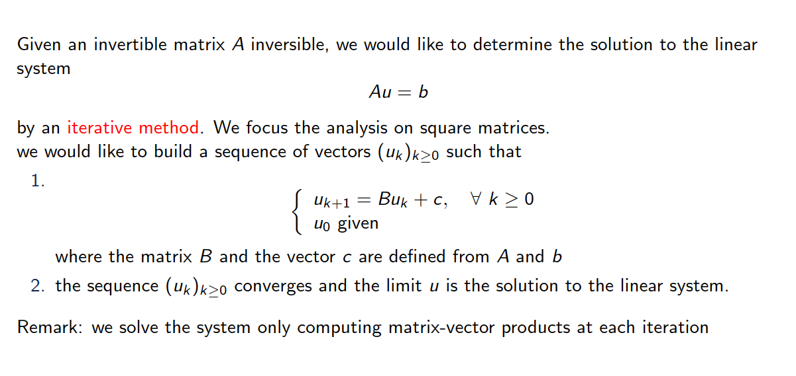
Introduction

Slide 39
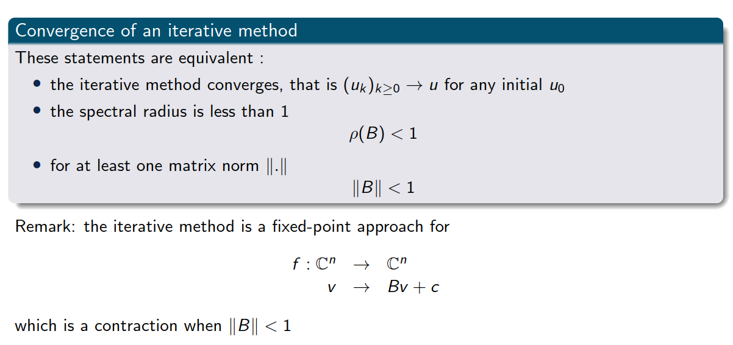
Some basic notions

Slide 40
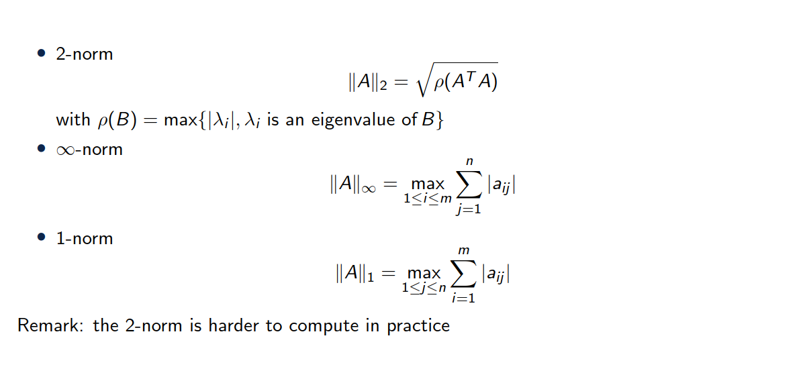
Some induced matrix norms

Slide 41
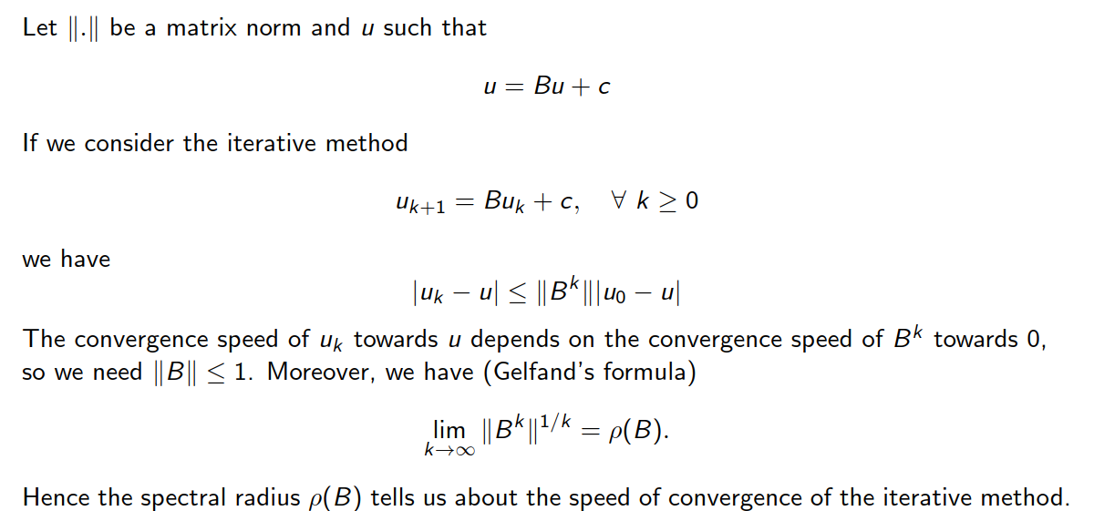
Speed of convergence

Slide 42
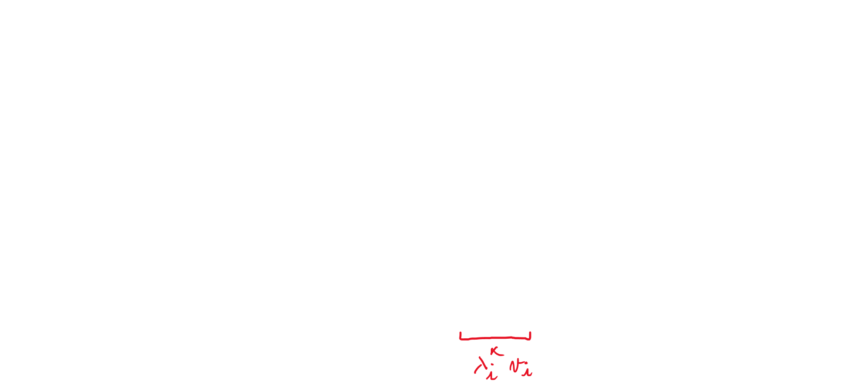



Why is spectral radius of B important?

Slide 43

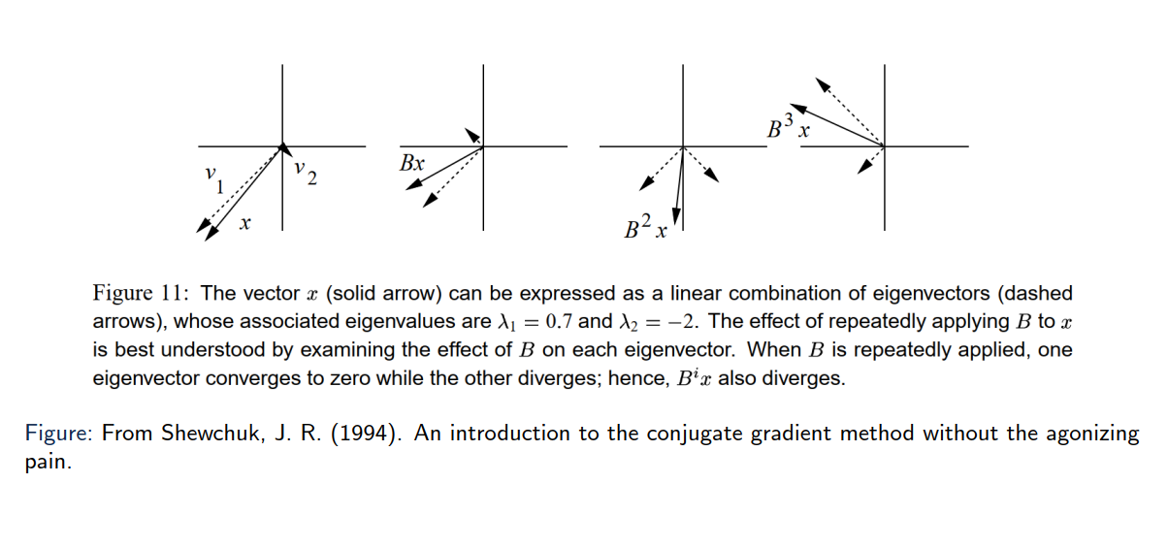
Geometrical interpretation
Eigen vectors only get scaled, not changed in direction!

Slide 44
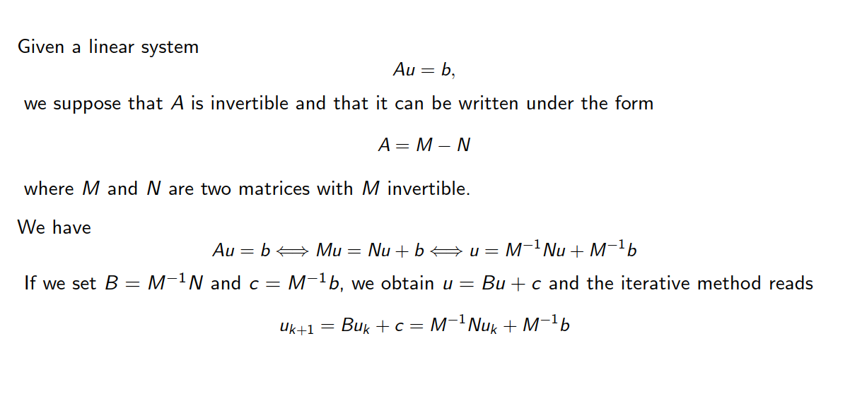
Another matrix decomposition

Slide 45
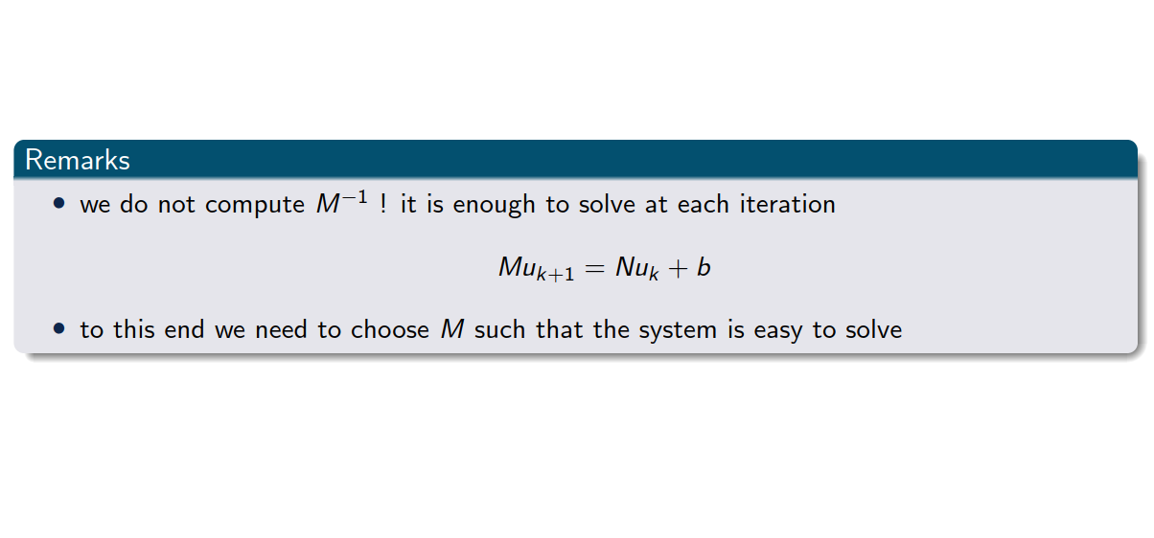
Another matrix decomposition

Slide 46
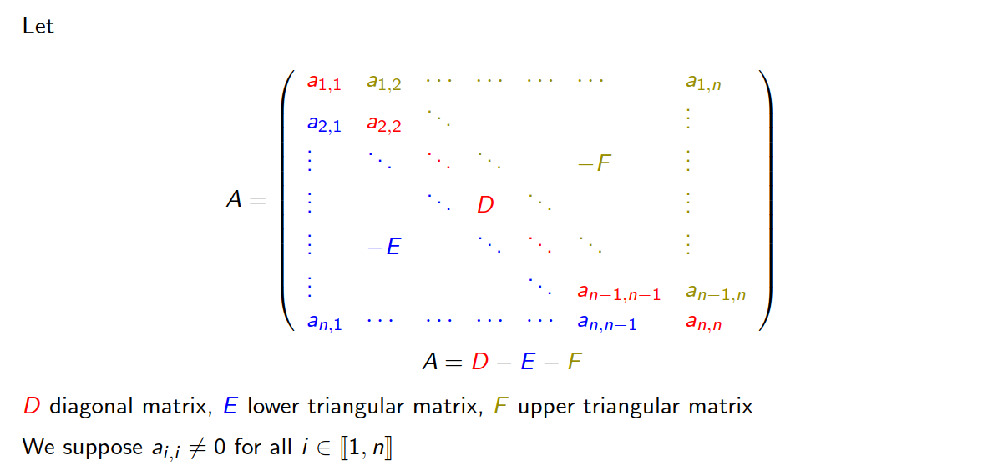
Towards a decomposition of A

Slide 47
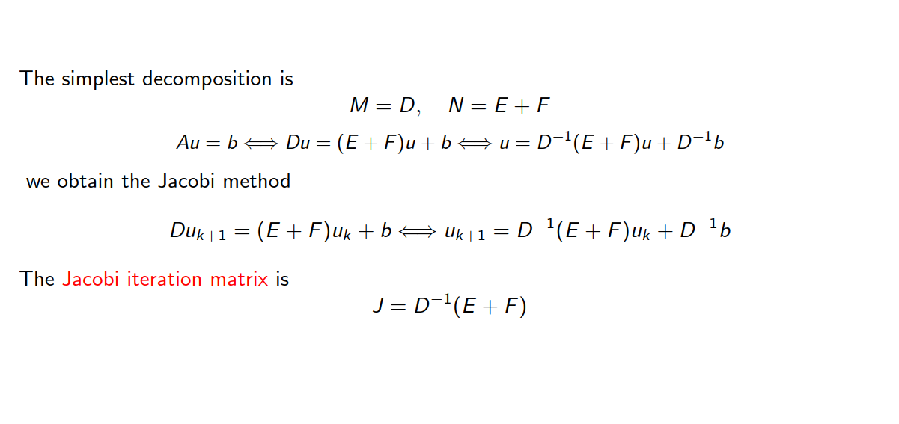
Jacobi iterative method

Slide 48
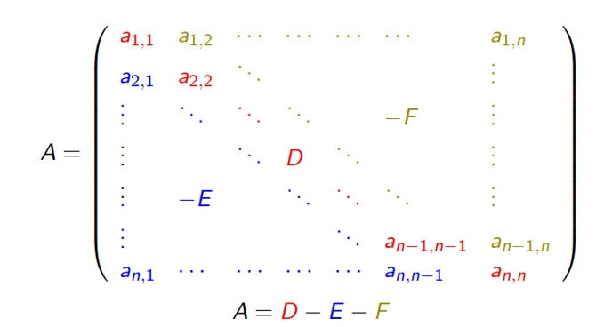
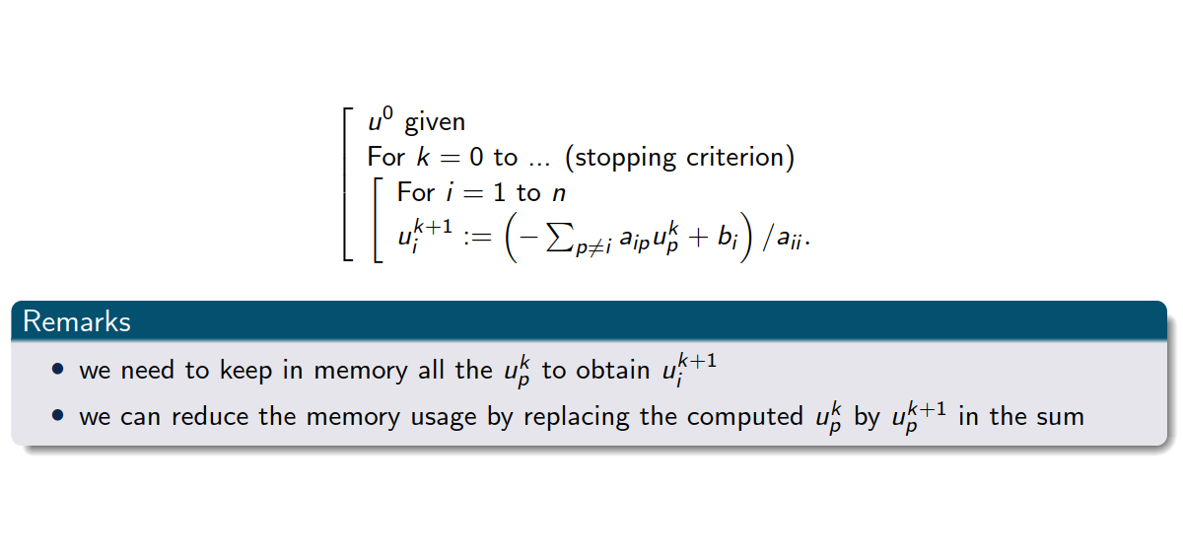

Jacobi iterative method
Pseudo code

Slide 49
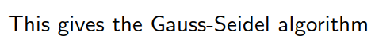

Gauss Seidel algorithm
Pseudo code

Slide 50
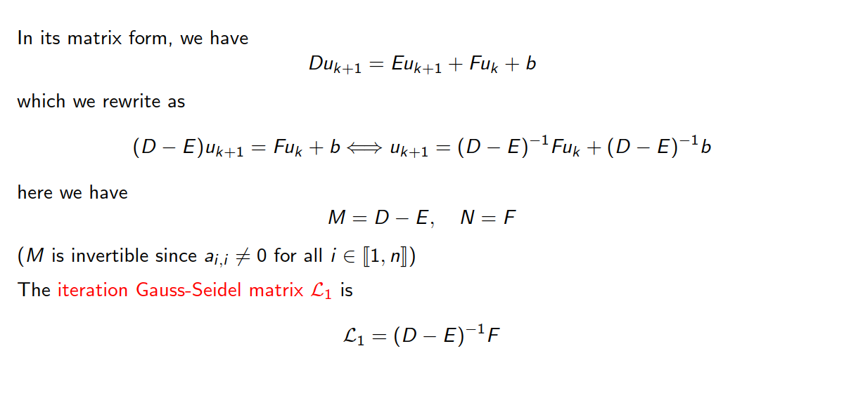
Gauss-Seidel iterative method

Slide 51
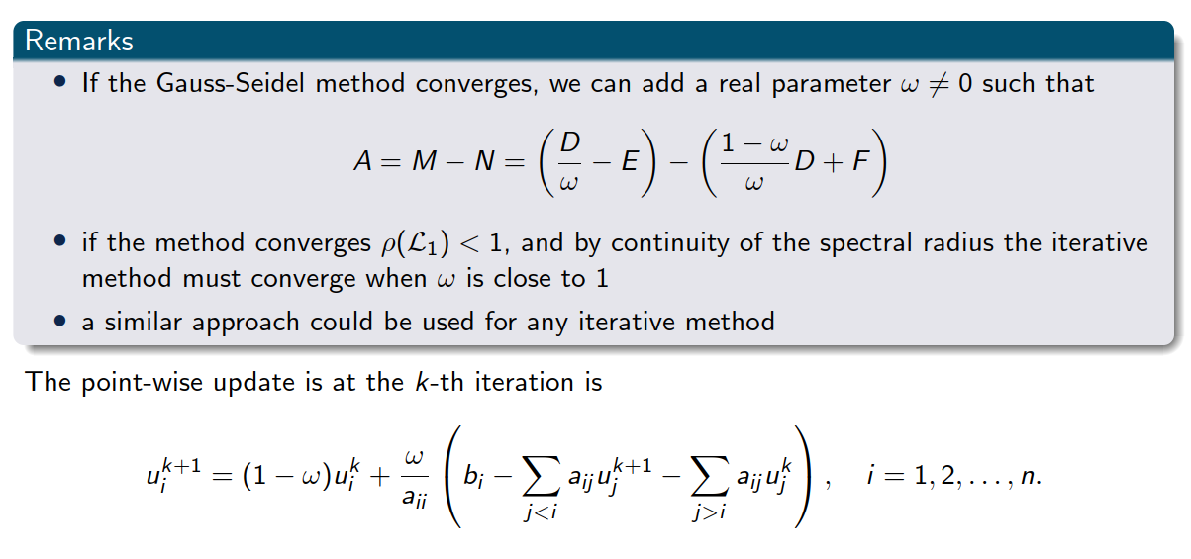
Relaxation method: Successive over-relaxation (SOR)

Slide 52











Relaxation method: Successive over-relaxation (SOR)

Slide 53
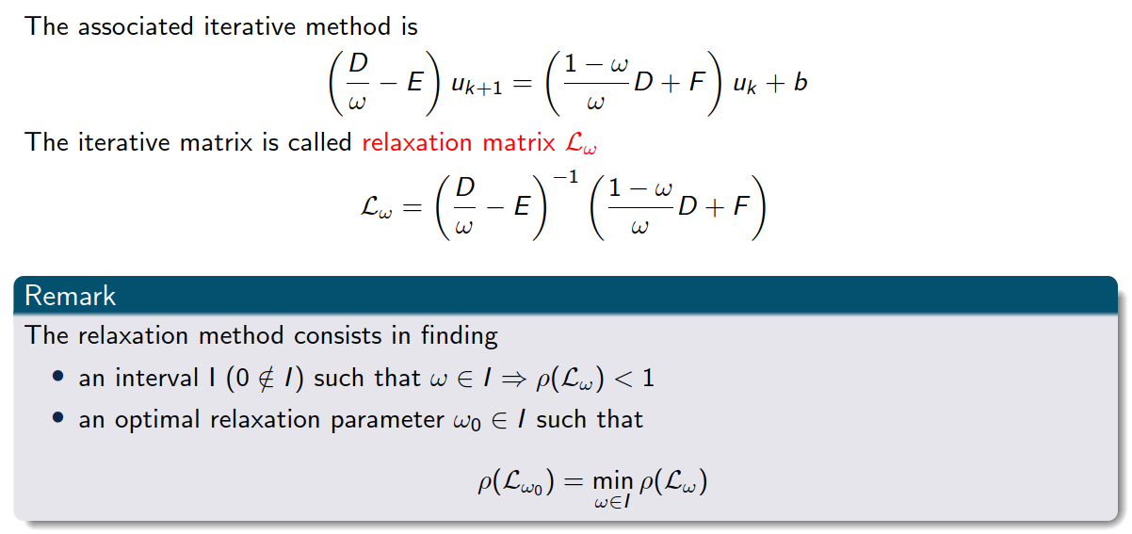
Relaxation method: Successive over-relaxation (SOR)

Slide 54
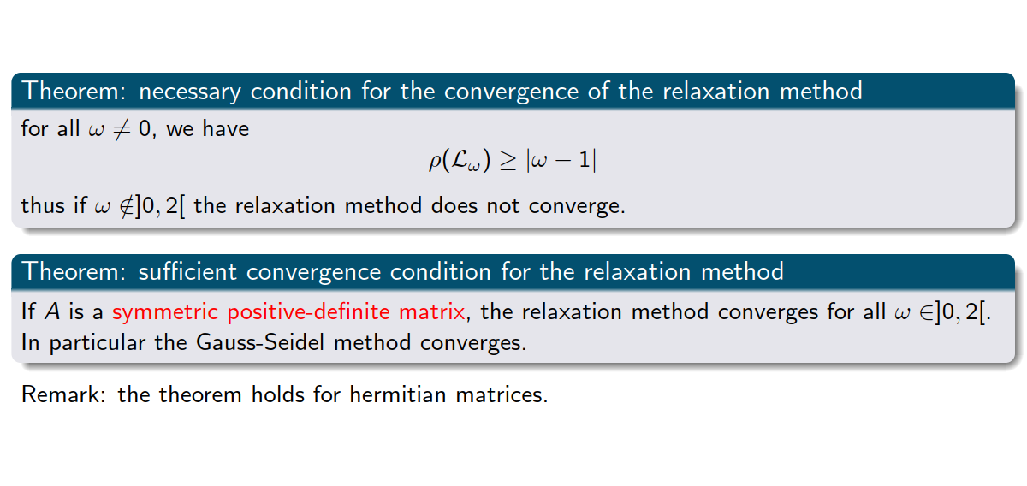
Convergence of SOR

Slide 55
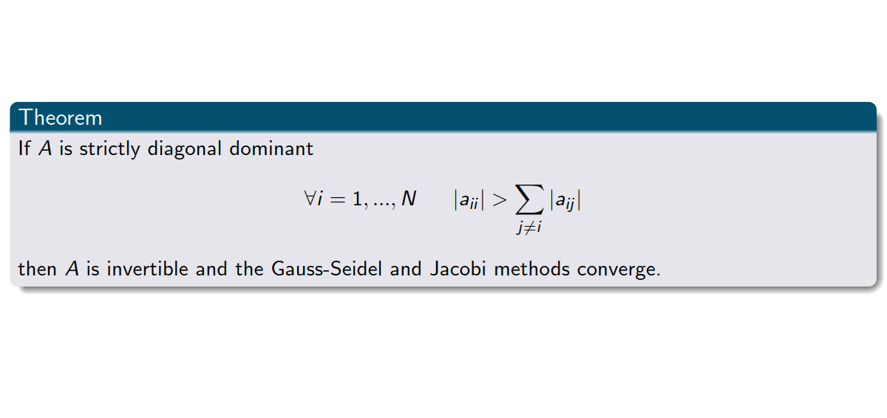
Convergence of Gauss-Seidel and Jacobi

Slide 56

In general

Slide 57

Matrices of type “V”

Slide 58

Matrices of type “V”

Slide 59

A few words about conditioning

Slide 60

A few words about conditioning
Exercise 5

Slide 61
6. Summary

Slide 62

Summary

